Slide 1

DIGITAL PORTFOLIO
STUDENT NAME: SARANYA R REGISTER NO:222410487 AND NIMD 72317A1E305A4EEB38F45A618B9F2AD9
DEPARTMENT:BSC. CS WITHAI
COLLEGE: COLLEGE/ UNIVERSITY (S.A COLLEGE OF ARTS & SCIENCE)/MADRAS UNIVERSITY

Slide 2
PROJECT TITLE
:
“CURRENT ACADEMIC PORFOLIO”
Current Academic portfolio using HTML, CSS, andJavascript.
Digital portfolio of current academic records
Personal Academic portfolio- SARANYA R

Slide 3
AGENDA
Problem Statement
Project Overview
End Users
Tools and Technologies
Portfolio design and Layout
Features and
Functionality
Results and Screenshots
Conclusion
Github Link

Slide 4
PROBLEM STATEMENT
In today’s digital world, students often struggle to present their academic achievements,
skills, and certifications in an organized and professional way. Traditional paper-based
resumes and certificates are not interactive and can easily be misplaced. Moreover, they do
not effectively highlight a student’s overall profile, including projects and personal goals.
Therefore, there is a need for a digital academic portfolio where students can showcase their
education, skills, certifications, and projects in one place.
This portfolio should be easily
accessible, visually appealing, and interactive so that it can be shared with teachers,
recruiters, and peers as proof of academic and personal development.

Slide 5
PROJECT OVERVIEW:
The Current Academic Portfolio is a web-based application developed using HTML, CSS, and JavaScript. It
serves as a digital resume for students, allowing them to present their academic achievements, skills,
certifications, and projects in an interactive and professional manner.
The portfolio is divided into multiple sections such as:
About Me – A brief introduction of the student. Education – Academic qualifications.
Skills – Technical and professional skills. Certificates – Achievements and certifications.
Projects – Mini/major projects completed. Contact – A form to reach the student.
This project provides an organized, accessible, and visually appealing platform for students to showcase their
profile, making it useful for internships, job opportunities, and academic purpose.

Slide 6
WHO ARE THE END USERS?
1. Students
* To showcase their academic achievements, skills, certificates, and projects.
*To use as a digital resume for internships and job applications.
Teachers / Mentors
To evaluate a student’s academic progress, skills, and project work.
To guide students in improving their professional profile.
Recruiters / Employers
To easily view the student’s qualifications, skills, and certifications.
To assess suitability for internships or job opportunities.
4. Peers / Academic Institutions
* To collaborate, share achievements, and maintain digital academic records.

Slide 7
TOOLS AND TECHNIQUES
Visual Studio Code (VS Code) – For coding and editing the project.
Web Browser (Google Chrome/Edge/Firefox) – For testing and running the portfolio.
GitHub / Localhost – For hosting and deployment .
MS PowerPoint / Canva – For preparing project documentation and presentations.
TechnologiesHTML5 – For structuring the web pages. CSS3 – For styling, layouts, and responsive design.
JavaScript – For adding interactivity and form validation.

Slide 8
POTFOLIO DESIGN AND LAYOUT
🔹 1. Header & Navigation Bar Positioned at the top of the page.
Contains the portfolio title (Student Name) and navigation links.
Links allow smooth scrolling to different sections: About, Education, Skills, Certificates,
Projects, and Contact.
Background color: Green (#4CAF50) for professional appearance.
🔹 2. About Section
Provides a short introduction of the student.
Includes name, course (BSC CS WITH AI), and ambition (to become a Software developer).
🔹 3. Education Section
Displays academic qualifications in a list format.
Covers current and past education (BSC CS WITH AI, 12th, 10th).Organized clearly for easy
understanding.

Slide 9
🔹 4. Skills Section
Skills are displayed in a grid-based card layout.
Each card contains one skill (HTML, CSS, JavaScript, Python, AI, UI/UX, DCA) Hover effect is applied for interactivity
🔹 5. Certificates Section
Highlights completed certifications in a card format.
Each card has a certificate name and a short description. Examples: AI, UI & UX Design, DCA
🔹 6. Projects Section
Lists mini/major projects completed.
Each project is shown in a card style with project name and short description. Example: Portfolio Website, Library Management System

Slide 10
🔹 7. Contact Section
Includes a contact form with Name, Email, and Message fields. Uses JavaScript validation to check inputs before submission. Provides an easy way for recruiters/teachers to reach the student.
🔹 8. Footer
Placed at the bottom of the page.
Contains copyright info (© 2025 saranya student Por.tfolio).
Styled with a dar k background for contrast.
.
🎨 Design Principles Followed
Responsive Design – Works on desktop, tablet, and mobile.
Minimal & Professional Look – Simple fonts and clean color scheme. Interactive Elements – Hover effects, smooth navigation, form validation. Organized Layout – Sections divided clearly for easy navigation.

Slide 11
FEATURES AND FUNCTIONALITY
🔹 Features
Single Page Portfolio – All student details are displayed on a single page with smooth navigation.
Responsive Design – Works well on desktop, tablet, and mobile devices.
Clean UI & Layout – Simple, card-based design for skills, certificates, and projects.
Interactive Elements – Hover effects on cards, smooth scrolling navigation.
Contact Form – Allows visitors to send messages to the student.
Organized Sections – About, Education, Skills, Certificates, Projects, and Contact are clearly separated.
Custom Styling – Consistent color theme (green & white) for a professional look.

Slide 12
🔹 Functionality
Navigation Bar – Links to different sections on the page.
About Section – Displays student introduction and ambition.
Education Section – Shows academic qualifications.
Skills Section – Lists technical/professional skills in card format.
Certificates Section – Highlights student certifications with details.
Projects Section – Displays mini/major projects with descriptions.
Contact Section –Input fields: Name, Email, Message.JavaScript validation checks for empty fields before submission.
Confirmation alert is shown on successful submission.

Slide 13
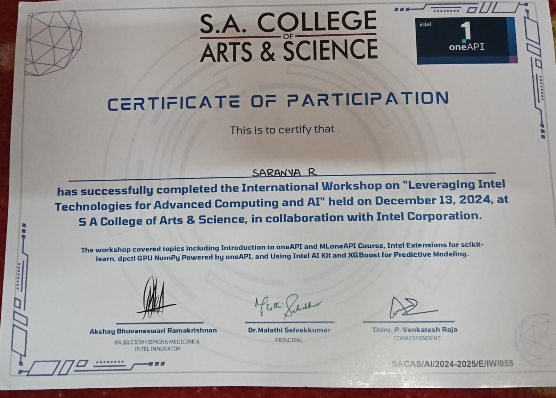

Slide 14
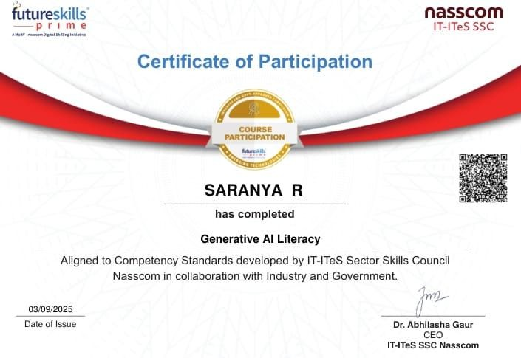

Slide 15
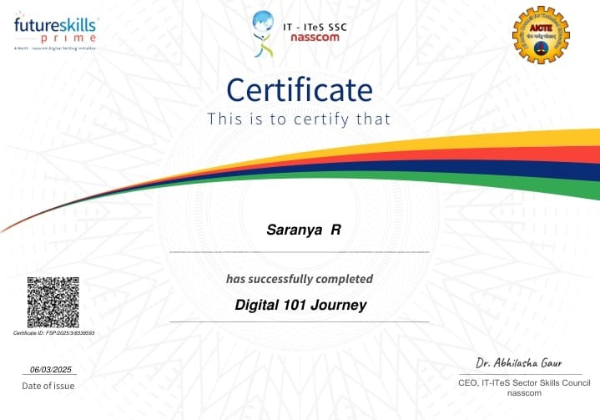

Slide 16
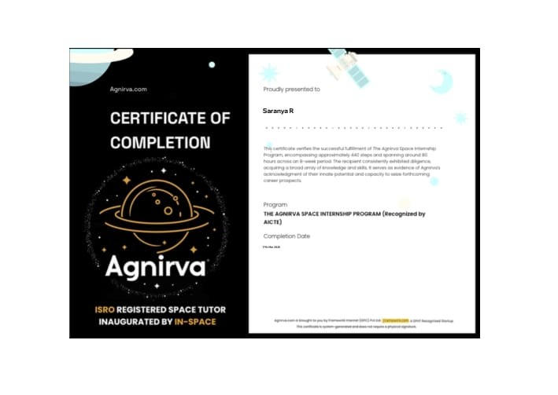

Slide 17
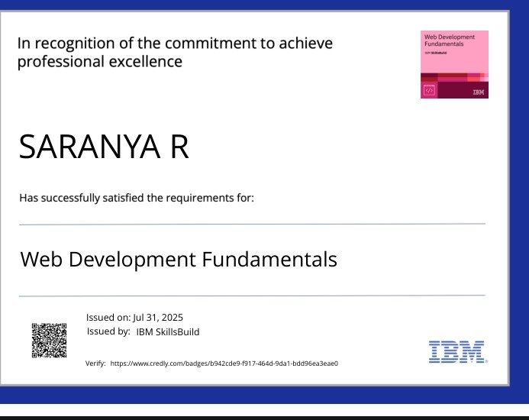

Slide 18
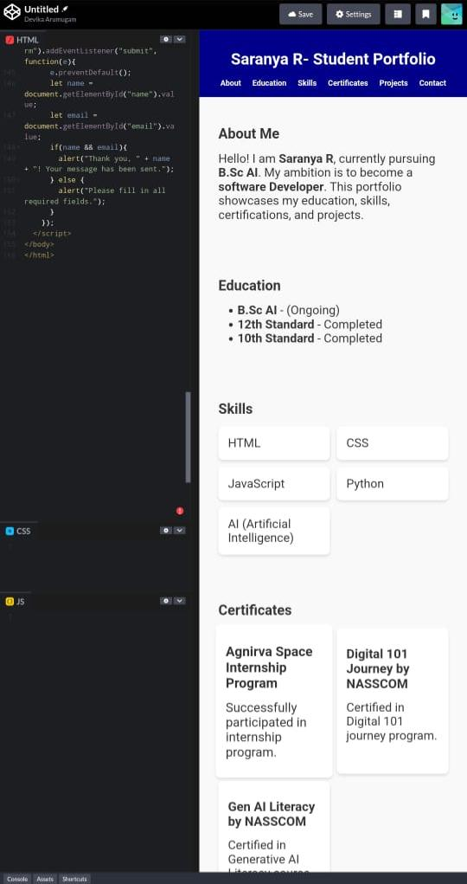
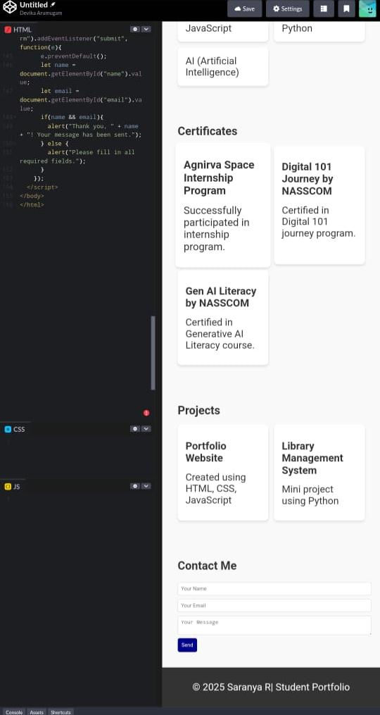

Slide 19
CONCLUSION:
The Current Academic Portfolio project successfully demonstrates how students can digitally showcase their academic qualifications, skills, certifications, and projects in a structured and professional way.
Unlike traditional paper-based resumes, this portfolio is interactive, responsive, and easily accessible online, making it more effective for academic purposes, internships, and job opportunities.
By using HTML, CSS, and JavaScript, the project provides a simple yet modern platform where students can highlight their strengths and achievements. This enhances their chances of being recognized by teachers, recruiters, and peers.
In conclusion, the project proves that digital portfolios are an essential tool for today’s students, enabling them to present themselves in a professional manner and stand out in the competitive world . 1

